Slide 1
Chapter 2
Distributed Computing Infrastructure
Mike P. Papazoglou
mikep@uvt.nl

Slide 2
Topics
Distributed computing and Internet protocols
The client–server model
Inter-process communication
Synchronous forms of middleware
Asynchronous forms of middleware
Request–reply messaging
Message-oriented middleware
Enterprise application and e-Business integration

Slide 3
Distributed Computing
A distributed system is characterized as a collection of heterogeneous networked computers, which communicate and coordinate their actions by passing messages.
  Distribution is transparent to the user so that the system appears as a single integrated facility.
One important characteristic of a distributed system is that processes are not executed on a single processor, but rather span a number of processors.
  This requires inter-process communication mechanisms.

Slide 4
Internet Protocols
Internet protocols are essentially methods of data transport across the Internet. They define the standards by which the different components in a distributed system communicate across the Internet with each other & with remote components.
The most prominent of the Internet protocols is transport control protocol over Internet protocol (or TCP/IP), which provide for the reliable delivery of streams of data from one host to another across the Internet:
  The Internet protocol (IP) enables the unreliable delivery of individual packets from one host to another.
    IP makes no guarantees as to whether the packet will be delivered, how long it will take, or if multiple packets will arrive in the order they were sent.
  The transport control protocol (TCP) adds the notions of connection and reliability.

Slide 5
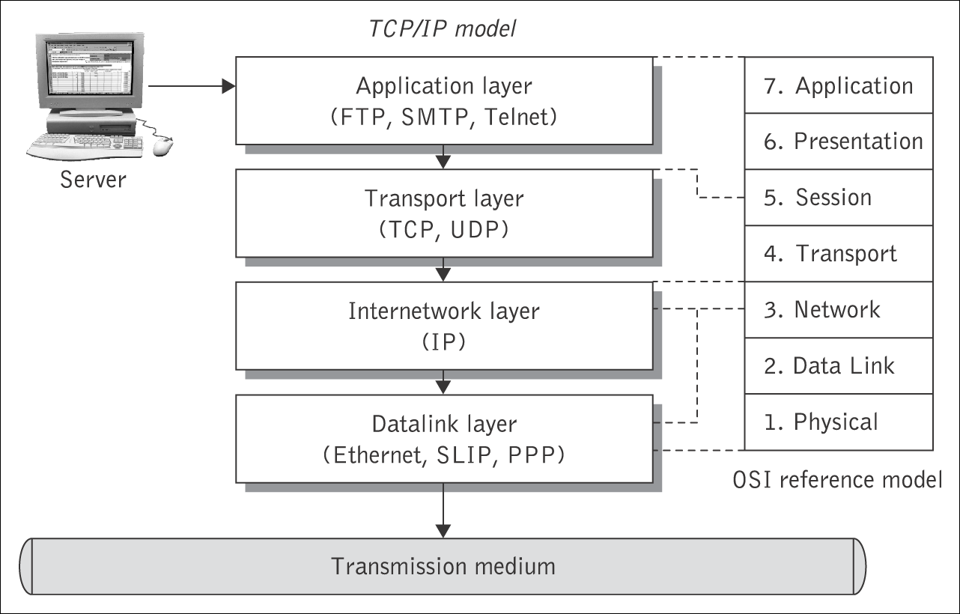
The TCP/IP protocol stack and its relation to the
ISO Reference Model
The data link layer provides the interface to the actual network hardware.
The inter-network layer is responsible for routing “blocks of data” from one host to another.
The transport layer provides end-to-end data transfer by delivering data between the client and server sides of an application.
The application layer is responsible for supporting network applications.

Slide 6
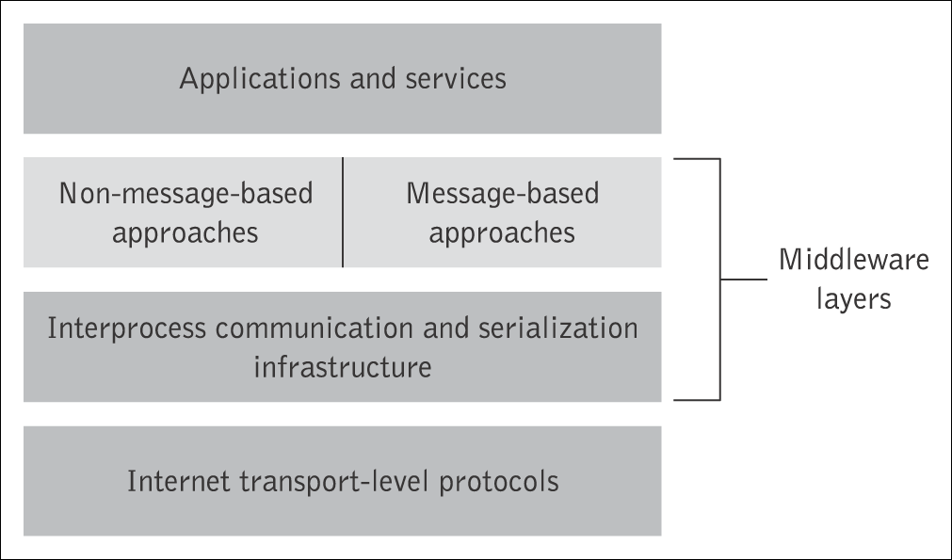
Middleware
Middleware provides a functional set of interfaces to allow an application to
  locate applications transparently across the network;
  shield software developers from low-level, tedious and error-prone platform details;
  provide a consistent set of higher level abstractions that are much closer to application requirements;
  leverage previous developments and reuse them;
  provide services such as reliability, availability, authentication, and security.

Slide 7
Topics
Distributed computing and Internet protocols
The client–server model
Inter-process communication
Synchronous forms of middleware
Asynchronous forms of middleware
Request–reply messaging
Message-oriented middleware
Enterprise application and e-Business integration

Slide 8
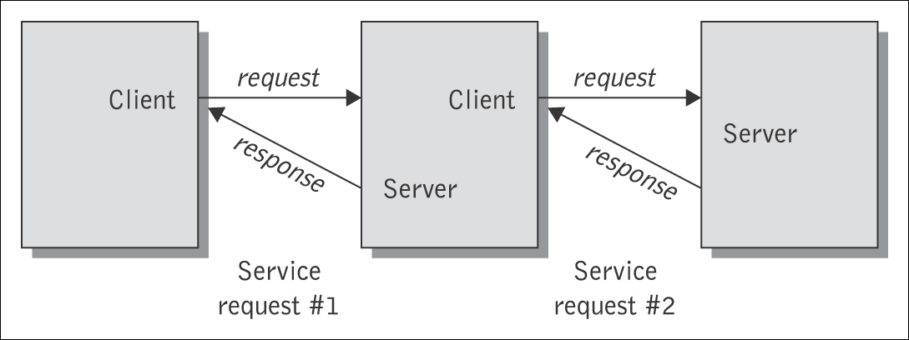
Client–server model
A client/server architecture is an architecture in which processing and storage tasks are divided between two classes of network members, clients & servers.
Client/server architecture involves client processes (service consumers) requesting service from server processes (service providers). Servers may in turn be clients of other servers.
  The client machine runs software and applications that are stored locally. The client makes requests to servers and is also responsible for the user interface.
  Some of the applications may be stored and executed on the server, but most of it is on the client. The server also provides the data for the application.
Source: From M. P. Papazoglou and P. M. A. Ribbers, e-Business: Organizational and Technical Foundations, J. Wiley & Sons, 2006. Reproduced with permission

Slide 9
Topics
Distributed computing and Internet protocols
The client–server model
Inter-process communication
Synchronous forms of middleware
Asynchronous forms of middleware
Request–reply messaging
Message-oriented middleware
Enterprise application and e-Business integration

Slide 10
Messaging
Distributed systems and applications communicate by exchanging messages. Messaging enables high-speed, asynchronous, program-to-program communication with reliable delivery.
Message passing between a pair of processes is supported by two message communication operations: send and receive, defined in terms of destinations and messages.
Marshalling (serialization) is the process of taking any form of structured data items and breaking up so that it can be transmitted as a stream of bytes over a communications network in such a way that the original structure can be reconstructed easily on the receiving end.
Unmarshalling (deserialization) is the process of converting the assembled stream of bytes on arrival to produce an equivalent form of structured data at the destination point.

Slide 11
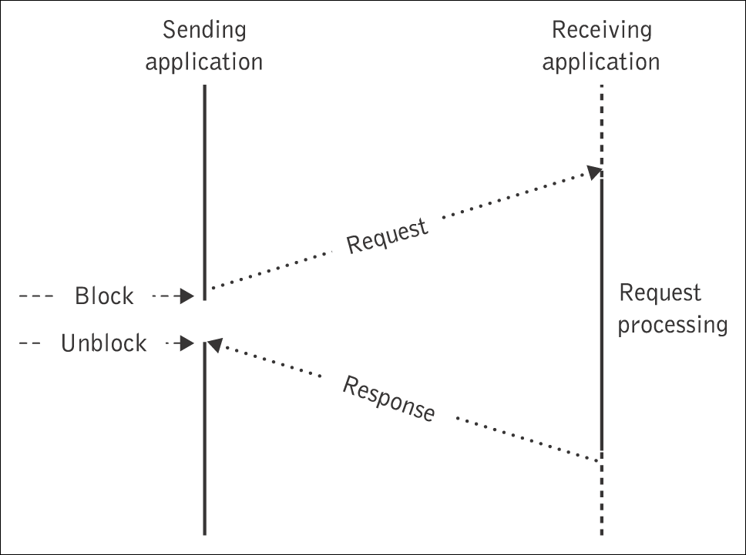
Synchronous and asynchronous messaging
There are two basic modes of message communication:
Synchronous communication – synchronized between two communicating application systems, which must both be up and running.
  Execution flow at the client’s side is interrupted to execute the call.
Asynchronous communication – the caller employs a send and forget approach that allows it to continue to execute after it sends the message.
  Here an application sends a request to another while it continues its own processing activities.

Slide 12
Topics
Distributed computing and Internet protocols
The client–server model
Inter-process communication
Synchronous forms of middleware
Asynchronous forms of middleware
Request–reply messaging
Message-oriented middleware
Enterprise application and e-Business integration

Slide 13
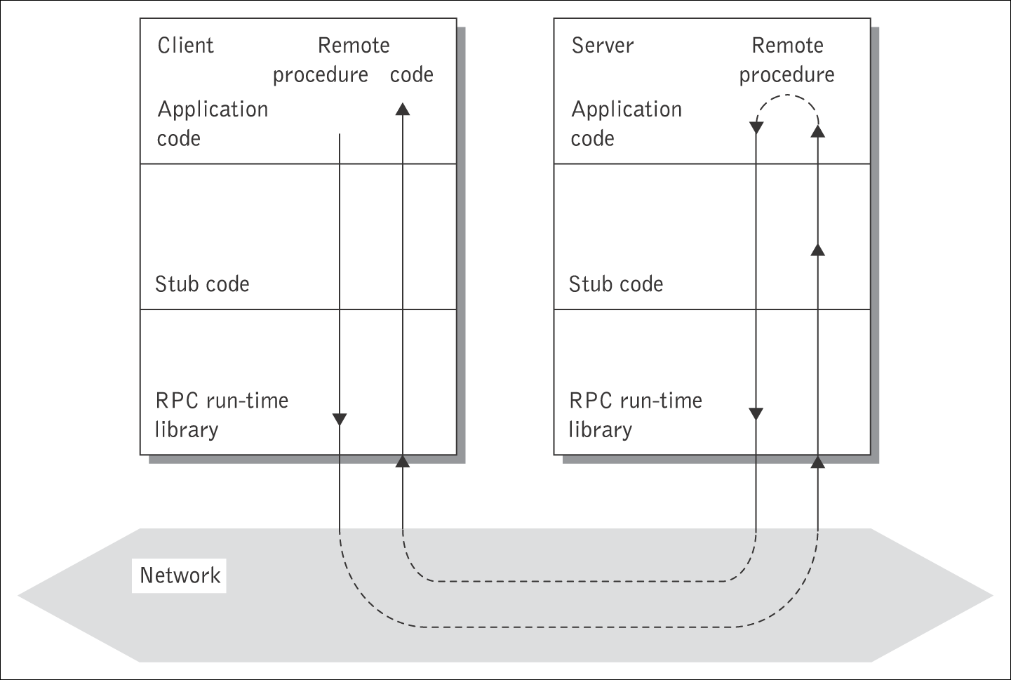
Remote procedure calls
RPC is a basic mechanism for inter-program communication, where the application elements use a request/wait-for-reply (synchronous) model of communication.
Source: From M. P. Papazoglou and P. M. A. Ribbers, e-Business: Organizational and Technical Foundations, J. Wiley & Sons, 2006. Reproduced with permission

Slide 14
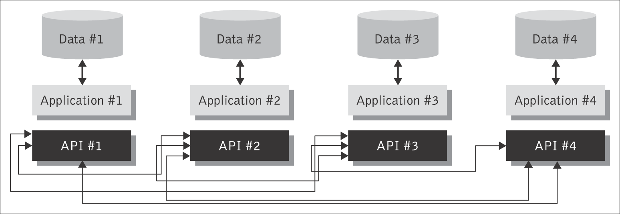
Tightly coupled RPC point-to-point integrations
RPC-style programming leads to tight coupling of interfaces and applications.
In an RPC environment each application needs to know the intimate details of the interface of every other application – the number of methods it exposes and the details of each method signature it exposes.

Slide 15
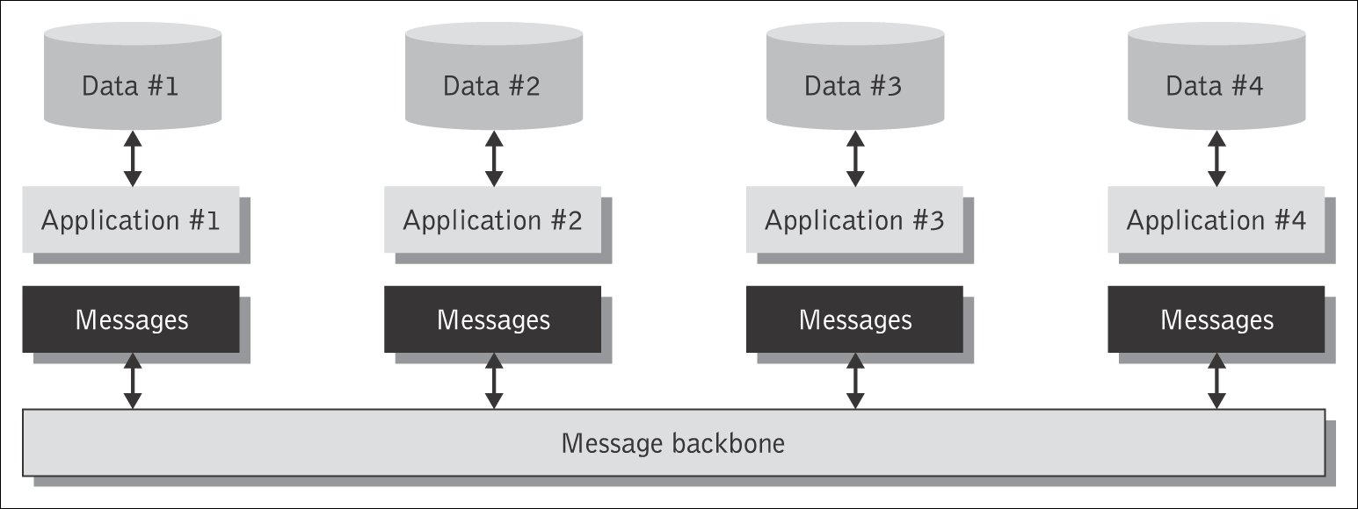
Asynchronous communication
Asynchronous communication promotes loose coupling in which an application does not need to know the intimate details of how to reach and interface with other applications.
Each participant in a multi-step business process flow needs only be concerned with ensuring that it can send a message to the messaging system.

Slide 16
Topics
Distributed computing and Internet protocols
The client–server model
Inter-process communication
Synchronous forms of middleware
Asynchronous forms of middleware
Request–reply messaging
Message-oriented middleware
Enterprise application and e-Business integration

Slide 17
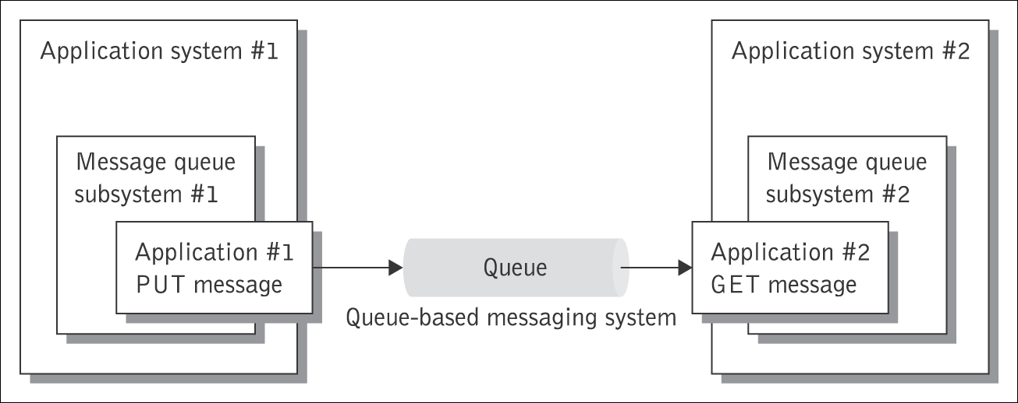
Store and forward messaging
With the store and forward queuing mechanism, messages are placed on a virtual channel called a message queue by a sending application and are retrieved by the receiving application as needed.
  The queue is a container that can hold the message until the recipient collects it.

Slide 18
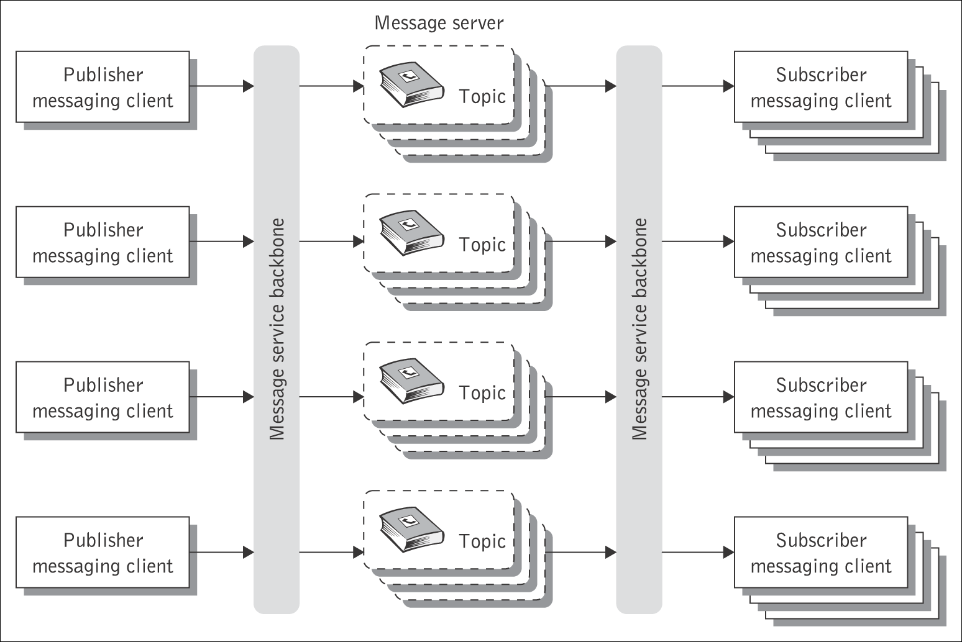
Publish/Subscribe Messaging
The application that produces information publishes it and all other applications that need this type of information subscribe to it.
  Messages containing
  the new information are
  placed in a queue for
  each subscriber by the
  publishing application.
  Each application
  may have a dual role:
  it may act as a publisher
  or subscriber of
  different types
  of information.

Slide 19
Event-driven processing mechanisms
The asynchrony, heterogeneity, and inherent loose coupling that characterize modern applications in a wide-area network requires event notification mechanisms.
Event notification offers a many-to-many communication and integration facility. Clients in an event-notification scheme are of two kinds:
  objects of interest, which are the producers of notifications, and
  interested parties, which are the consumers of notifications.
A client can act as both an object of interest and an interested party. An event notification service typically realizes the publish/subscribe asynchronous messaging scheme.

Slide 20
Topics
Distributed computing and Internet protocols
The client–server model
Inter-process communication
Synchronous forms of middleware
Asynchronous forms of middleware
Request–reply messaging
Message-oriented middleware
Enterprise application and e-Business integration

Slide 21
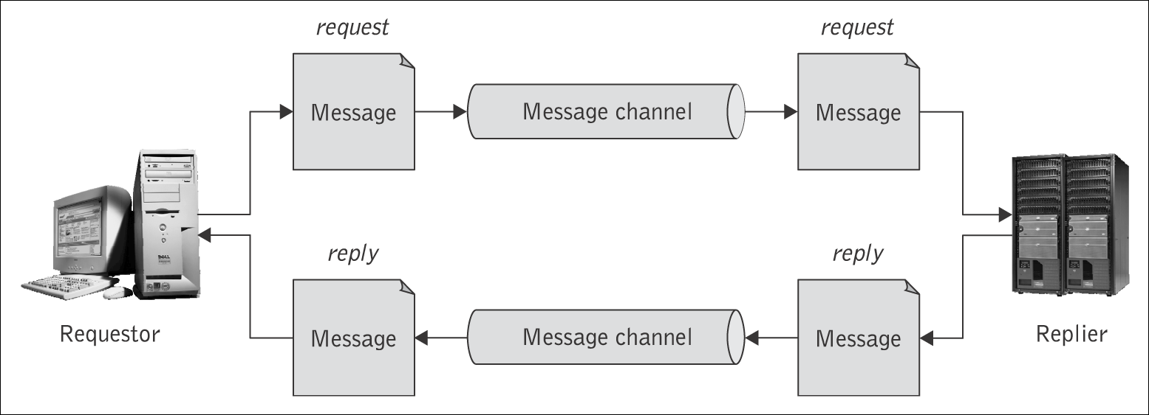
Asynchronous request/reply messaging
Most asynchronous messaging mechanisms follow the “fire-and-forget” messaging principle where the sending application can conduct its work as usual once a message was asynchronously sent.
  The sending application assumes that the message will arrive safely at its destination at some point in time.
  This mode of messaging does not preclude the necessity to perform request/reply operations.

Slide 22
Topics
Distributed computing and Internet protocols
The client–server model
Inter-process communication
Synchronous forms of middleware
Asynchronous forms of middleware
Request–reply messaging
Message-oriented middleware
Enterprise application and e-Business integration

Slide 23
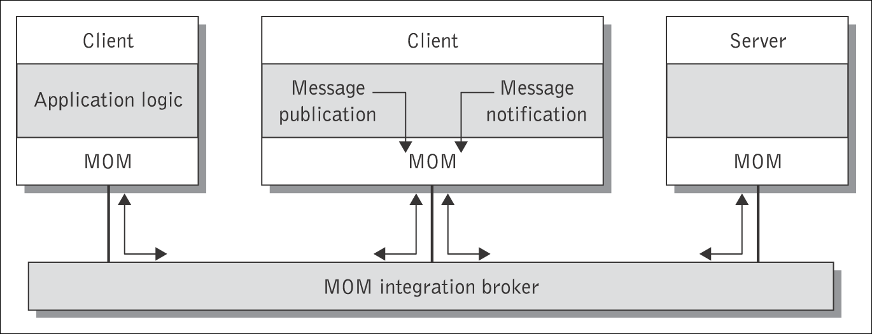
Message-oriented Middleware
MOM is an infrastructure that involves the passing of data between applications using a common communication channel that carries self-contained messages.
Messages are sent and received asynchronously.
The messaging system (integration broker) is responsible for managing the connection points between clients and for managing multiple channels of communication between the connection points.
Source: From M. P. Papazoglou and P. M. A. Ribbers, e-Business: Organizational and Technical Foundations, J. Wiley & Sons Limited, 2006. Reproduced with permission

Slide 24
Message-oriented Middleware (continued)
MOM provides the following functions:
  event-driven processing, i.e., the publish/subscribe model;
  reliability and serialization of messages;
  subject-based (textual) names and attributes to abstract from physical names and addresses;
  multiple communications protocols, e.g., store and forward, request/reply, publish/subscribe.
An integration broker is an application-to-application middleware service capable of one-to-many, many-to-one and many-to-many message distribution.
  It records and manages the contracts between publishers and subscribers of messages.
An integration broker provides the following functions:
  message transformation, business rules processing, routing services, naming services, adapter services, repository services, events, and alerts.

Slide 25
Topics
Distributed computing and Internet protocols
The client–server model
Inter-process communication
Synchronous forms of middleware
Asynchronous forms of middleware
Request–reply messaging
Message-oriented middleware
Enterprise application and e-Business integration

Slide 26
Enterprise Application Integration (EAI)
EAI has emerged to help organizations eliminate islands of data and automation and integrate diverse custom and package applications (including legacy).
The objective of EAI is to transform an organization’s internal applications into a cohesive corporate framework.
EAI enables applications throughout the enterprise to integrate seamlessly in the form of business processes.
The internal applications in an enterprise that EAI attempts to integrate are called enterprise information systems. These include the following:
  Custom applications
  Legacy and database applications
  Enterprise resource planning systems
  Customer relationship management systems
  Transaction systems.

Slide 27
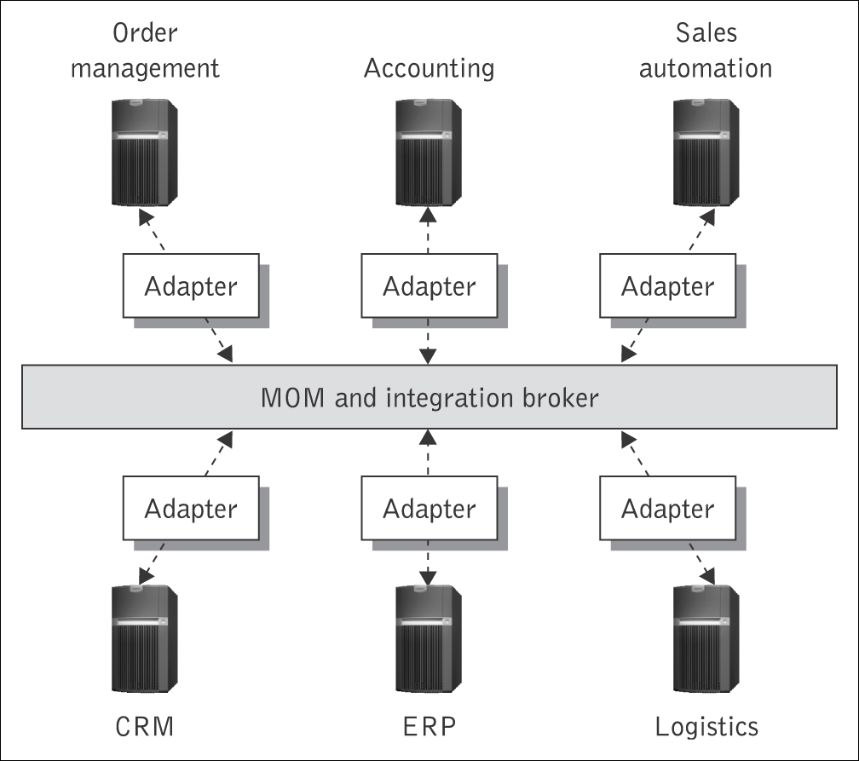
EAI (continued)
EAI uses a fast, robust communications backbone with integration broker technology, business process workflow, and facilities tools.
  Integration brokers are
  used for message process
  flow & are responsible for
  brokering messages
  exchanged between two or
  more applications.
  They provide the ability to
    transform
    store and route messages
    apply business rules and
    respond to events.

Slide 28
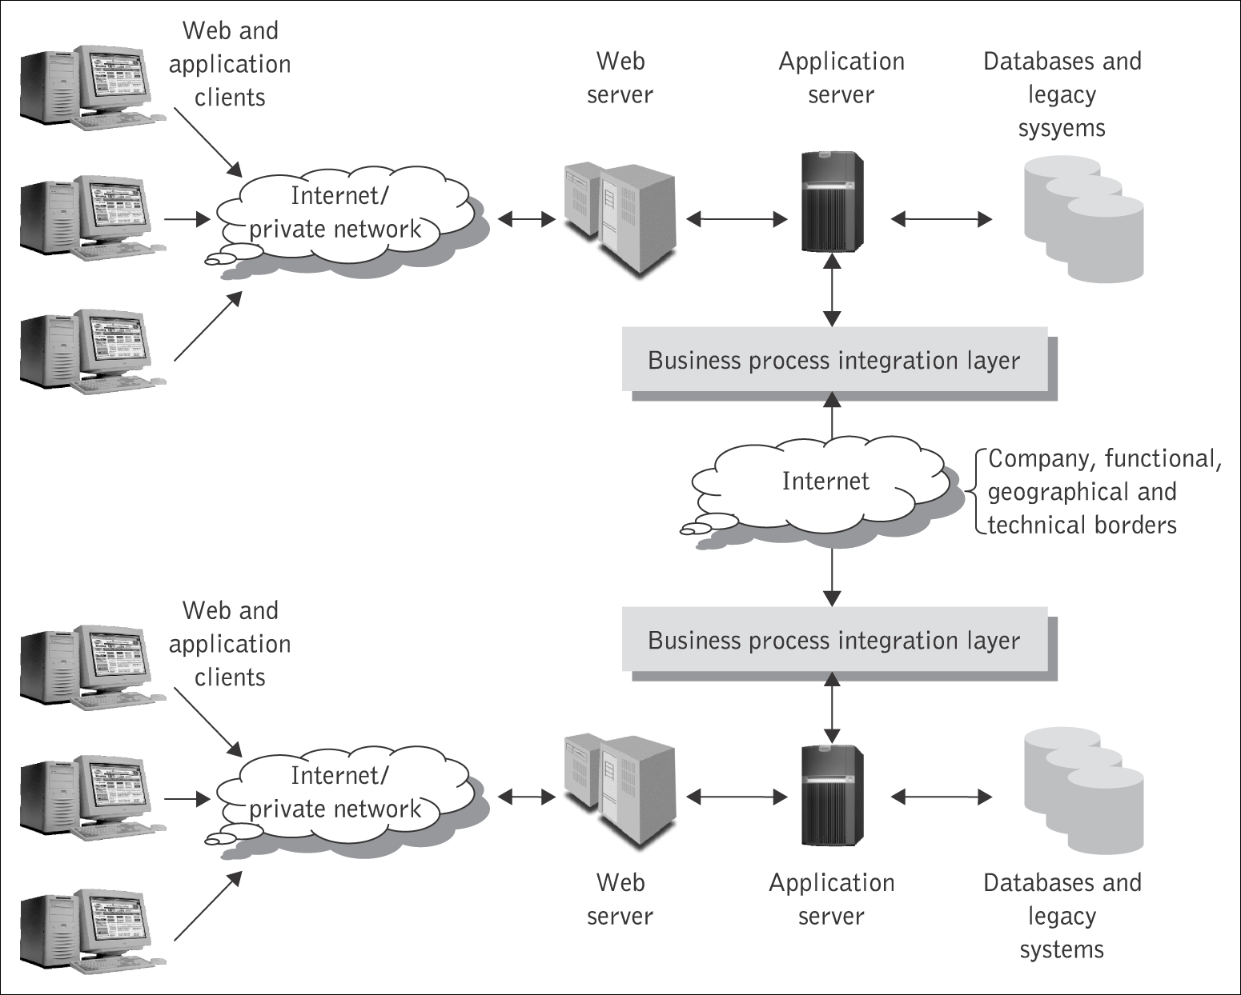
e-Business integration
e-Business integration solutions grow on the back of successful internal EAI solutions and provide the capability to link together disparate processes between trading partners.
  systems internal to an enterprise are able to interact with those of customers, suppliers, and partners.

